Slide 1
Background

Slide 2
Human-Wildlife conflict
What is HWC?
Humans and wildlife are cohabiting in the same space
Positive and negative interaction happens with it
The unwanted negative interaction between humans and wildlife is termed as HWC.
HWC is also a human-human conflict due to the conflict of interest between the stakeholders.

Slide 3
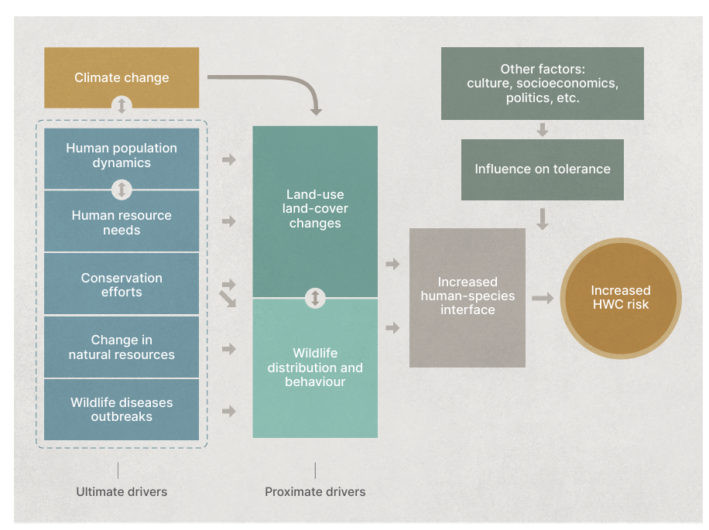
Reasons of HWC
Including but not limited to
Decrease in forest land,
Decrease in the health of existing forest –
forest degradation,
Plantations
Invasive species
Lack of open forests
Fragmentation of forest land
Behavioral change in wildlife(under-studied)
Lack of suitable predators
Drying of water resources,
Climate change (understudied)
Figure 1: Drivers of increased human-wildlife interface; IUCN(2023)

Slide 4
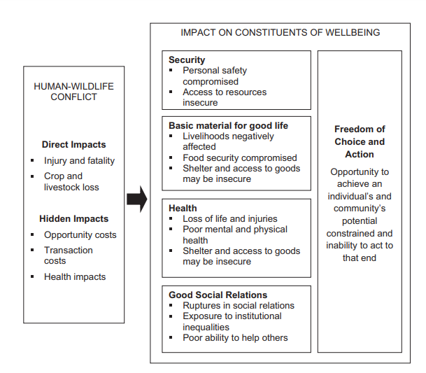
Impacts of Human-wildlife conflict
Direct impacts
Crop loss
Livestock loss
Injury and fatality
Habitat loss
Indirect impacts
(Karanth & Treves,2003; FAO, 2005, Manfredo,2008; Woodroffe et. al, 2005;Barua. M. et. al, 2013; Nyhus, 2016)

Slide 5
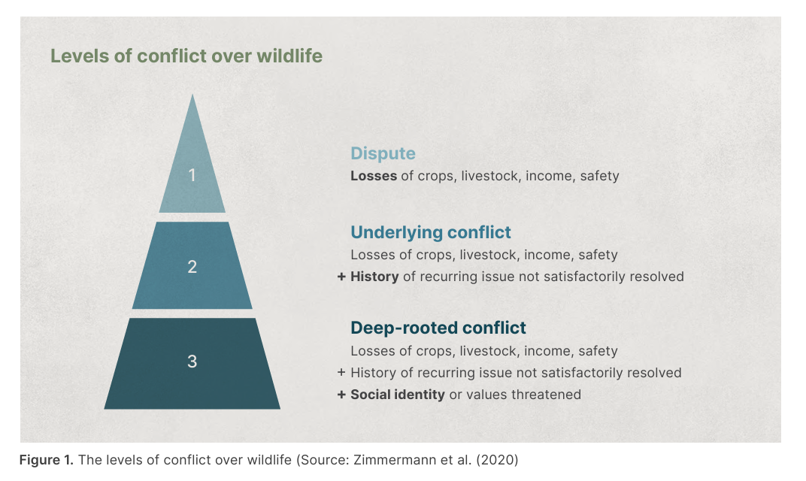
Levels of conflict – solutions should be made by realizing the level of conflict

Slide 6
Mitigation measures followed in Kerala
Mitigative actions carried out by individuals, and the forest department
Deterrents – audio, sensory deterrents (torching lights, use of sounds, etc.)
Elephant proof trenches
Fencing – Electric fencing, Solar fencing
Bio fencing – certain species of plants, Bee-hive fencing (not widely used)
Rock walls
Alert systems

Slide 7
Are conflicts increasing in Kerala?
HWC is a site-specific issue; Each region has specific reasons – historic, geographic reasons, attitude of humans, and more
Reporting has increased – could be because of increased awareness, and ease of applying (online)
Delay in compensation payment
Existing mitigation measures are not well-maintained (fences, trenches, etc.)
Increased friction between the forest department and forest-proximate people.
In Kerala, the landscapes adjacent to the forest are a mosaic of forest land, human settlements, and agricultural fields.

Slide 8
Short comings

